Slide 1
Cloud Computing Architecture
Abhirup Khanna

Slide 2
INTRODUCTION
The cloud vision of the datacenter represents not only a new provisioning model but also a way to simplify and optimize infrastructure operation because applications are not tied to a specific physical server and data is not attached to a single storage device
Turning this vision into reality requires developing an open and flexible cloud architecture reference model that addresses the requirements of business use cases from IT companies and across multiple industries.
This model should also provide some basic features such as adaptability to manage any hardware and software combination, interoperability and portability to prevent vendor lock-in, scalability to support large-scale infrastructures, and standardization by leveraging and implementing standards.

Slide 3
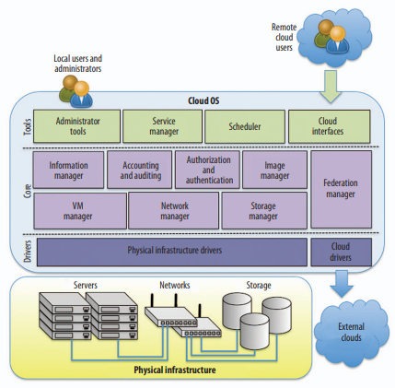

Slide 4
COMPONENTS OF IAAS ARCHITECTURE
The key component of an IaaS cloud architecture is the cloud OS, which manages the physical and virtual infrastructures and controls the provisioning of virtual resources according to the needs of the user services.
There are many similarities between a typical computer system’s threaded OS and a cloud OS.
A computer OS’s main role is to manage the computer resources—the CPU, memory, disks, and I/O devices—and provide a secure and isolated multithreaded execution environment for user applications.
This environment enables resource sharing between different users, abstracting the user from the specifics of the underlying hardware and offering different interfaces for interacting with the computer.

Slide 5
COMPONENTS OF IAAS ARCHITECTURE
Similarly, a cloud OS’s role is to efficiently manage datacenter resources to deliver a flexible, secure, and isolated multitenant execution environment for user services that abstracts the underlying physical infrastructure and offers different interfaces and APIs for interacting with the cloud.
While local users and administrators can interact with the cloud using local interfaces and administrative tools that offer rich functionality for managing, controlling, and monitoring the virtual and physical infrastructure, remote cloud users employ public cloud interfaces that usually provide more limited functionality.

Slide 6
COMPONENTS OF IAAS ARCHITECTURE
To provide an abstraction of the underlying infrastructure technology, the cloud OS can use adapters or drivers to interact with a variety of virtualization technologies.
The core cloud OS components, including the virtual machine (VM) manager, network manager, storage manager, and information manager, rely on these infrastructure drivers to deploy, manage, and monitor the virtualized infrastructures.

Slide 7
Virtual Machine Manager
In the same way that a multithreaded OS defines the thread as the unit of execution and the multithreaded application as the management entity supporting several communication and synchronization instruments.
A cloud OS defines the VM as the basic execution unit and the virtualized services (group of VMs for executing a multitier service) as the basic management entity supporting different communication instruments and their auto configuration at boot time.
This concept helps create scalable applications because the user can either add VMs as needed (horizontal scaling) or resize a VM (if supported by the underlying hypervisor technology) to satisfy a VM workload increase (vertical scaling).

Slide 8
Virtual Machine Manager
A VM consists of a set of parameters and attributes, including the OS kernel, VM image, memory and CPU capacity, network interfaces, and so on.
The VM manager is responsible for managing a VM’s entire life cycle and performing different VM actions—deploy, migrate, suspend, resume, shut down—according to user commands or scheduling strategies.
The VM manager is also responsible for preserving the service-level agreements contracted with the users, which are usually expressed in terms of VM availability in infrastructure clouds.
To guarantee this availability, the VM manager should include different mechanisms for detecting VM crashes and automatically restarting the VM in case of failure.

Slide 9
Network Manager
The deployment of services in a cloud involves not only the provision of VMs but also the instantiation of communication networks to interconnect the different service components and to make the service reachable for external users, if needed.
The network manager should be able to manage private networks to interconnect both the service’s internal components and public IP address pools and connect the front-end service components to the Internet.
As different virtual networks can share a common physical link, the network manager should provide an automated procedure for MAC and IP address assignment to avoid address overlap problems.

Slide 10
Storage Manager
The storage manager’s main function is to provide storage services and final-user virtual storage systems as a commodity. Thus, the storage system must be scalable so that it can grow dynamically according to
service needs
highly available and reliable
to avoid data access disruption in data access in case of failure
high-performance
to support strong demands of data-intensive workloads
and easy to manage, abstracting users from the underlying physical storage’s complexity.
Enables the creation of a storage resource pool where storage devices appear as one, allowing data to be moved freely among devices.

Slide 11
Image Manager
Image management is an important challenge in current virtualized datacenters, since they must handle a huge amount of VM images belonging to different users, with different operating systems and software configurations.
Thus, the cloud OS must have the appropriate tools to manage these images efficiently and securely, as well as having additional functionality for administering image repositories.

Slide 12
Image Manager
A set of attributes defines the VM image, including the image’s name, a description of its contents, the type of image—public, private, or shared—the image owner, and the image’s location within the repository.
Basic image functionality should include tools for creating a new image in a repository, deleting an image, cloning an image from an existing one, adding or changing an image, attribute, sharing an image with other users, publishing an image for public use, or listing the images available in the repository.

Slide 13
Information Manager
The information manager is responsible for monitoring and gathering information about the state of VMs, physical servers, and other components of virtual and physical infrastructures such as network devices and storage systems.
This monitoring function is essential to ensure that all these components are performing optimally.
The information manager uses the information drivers to collect monitoring information from virtual and physical resources.

Slide 14
Information Manager
The information manager can provide various predefined sensors, each one responsible for a different aspect of the system to be monitored such as
CPU load
memory usage
running processes
disk usage
power consumption
and bandwidth consumption.
It is also possible to design custom sensors to use in monitoring new metrics adapted to the characteristics of the deployed service or to collect information about various VMs performing a service.

Slide 15
Authentication and Authorization
As in any kind of shared environment, clouds must incorporate mechanisms to authenticate users and administrators and to provide them with access only to authorized resources.
User authentication verifies and confirms the identity of users who try to access cloud resources.
This function can be implemented using different methods, such as simple password verification mechanisms or another kind of active directory; trusted authentication mechanisms based on public keys and security certificates.

Slide 16
Authentication and Authorization
Authorization policies control and manage user privileges and permissions to access different cloud resources, such as VMs, networks, or storage systems.
Access control can be implemented using role-based mechanisms, where a role defines a group of permissions to perform certain operations over specific cloud resources and users can be assigned particular roles.
In addition, quota mechanisms can be used to limit the amount of resources—CPU, memory, network bandwidth, or disk—a specific user can access.

Slide 17
Accounting and Auditing
Accounting’s objective is to obtain and record resource usage information of deployed services.
This function relies on the information manager to monitor resources and collect usage information from metric measurements.
Accounting is essential to implementing the mechanisms that produce billing information.
Auditing provides information about activity in cloud resources, indicating who accessed cloud resources, when they gained access, and what operations they performed

Slide 18
Federation Manager
The federation manager enables access to remote cloud infrastructures, which can be either partner infrastructures governed by a similar cloud OS entity or public cloud providers.
The federation manager should provide basic mechanisms for deployment, runtime management, and termination of virtual resources in remote clouds; remote resource monitoring; user authentication in remote cloud instances; access control management and remote resource permission; and tools for image building on different clouds with different image formats

Slide 19
Federation Manager
The federation manager’s design could differ depending on the supported types of federation—for example, cloud aggregation, bursting, or brokering—and levels of coupling and interoperability.
However, user-level federation scenarios could be implemented with a third-party stand-alone service, such as Aeolus (http://aeolusproject.org), which offers brokering services to access different cloud providers

Slide 20
Scheduler
There are two levels of scheduling within a cloud infrastructure:
at the physical host level, managed by the hypervisor scheduler, which is responsible for deciding when VMs can obtain system resources—such as physical CPU or memory—and which physical CPUs are assigned to each VM;
and at the cloud level, managed by the cloud OS scheduler, which is responsible for deciding the particular physical server where each VM is deployed.
In a federated environment, the scheduler could decide to deploy the VM in a remote cloud when insufficient resources are available in the local infrastructure

Slide 21
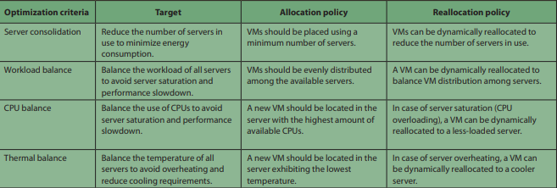
Scheduler
The following table lists different scheduling policies, based on varying optimization criteria, to guide both initial placement and dynamic reallocation actions.

Slide 22
Service Manager
The service manager’s admission control function entails deciding whether to accept or reject a service, depending on the service requirements and resource availability in the cloud.
Once it accepts a service, the service manager is responsible for managing its life cycle, which can involve several actions, including deploying, suspending, resuming, or canceling the service.
To deploy a new service, the service manager interacts with the scheduler to decide the best placement for the various VMs that comprise the service, according to the selected optimization criteria and service constraints.

Slide 23
Service Manager
Another service manager function is the management of service elasticity. Elastic services can experience fluctuating workloads, and the service manager should adapt the capacity to this variable demand.
The service manager can incorporate different mechanisms for service auto scaling based on elasticity rules, which trigger the deployment of new instances (horizontal scaling) or by resizing existing instances (vertical scaling) when user-specified service metrics exceed certain thresholds.

Slide 24
Cloud Interfaces
Cloud OS functionality can be exposed to consumers using some well-known public cloud interfaces. In the current cloud ecosystem, most cloud products and providers offer their own APIs, such as Amazon EC2 or VMware’s vCloud.
Although some of these APIs are becoming de facto standards, this heterogeneity makes it difficult to achieve interoperability and portability across clouds.

Slide 25
THANK YOU

